Slide 1

COMPUTER NETWORK (BCA301)
DEPARTMENT OF COMPUTER SCIENCE
PROGRAMME: BCA
CENTRAL UNIVERSITY OF ORISSA
KORAPUT

Slide 2
INTRODUCTION
The word data refers to information presented in various form that is text, audio, video etc.
Communication means sharing of information/data.
Telecommunication(Greek word "Tele" means Far) means communication at a distance.
Data communications are the exchange of data between two devices via some form of transmission medium such as a wire cable.
A communication system made up of a combination of hardware (physical equipment) and software (programs).

Slide 3
COMPONENTS
Message: The message is the information (data) to be communicated. Popular forms of information include text, numbers, pictures, audio, and video.
Sender: The sender is the device that sends the data message. It can be a computer, workstation, telephone handset, video camera, and so on.
Receiver: The receiver is the device that receives the message. It can be a computer, workstation, telephone handset, television, and so on.
Transmission medium: The transmission medium is the physical path by which a message travels from sender to receiver. Some examples of transmission media include twisted-pair wire, coaxial cable, fiber-optic cable, and radio waves.
Protocol: A protocol is a set of rules that govern data communications. It represents an agreement between the communicating devices. Without a protocol, two devices may be connected but not communicating.

Slide 4
CHARACTERSTICS
The effectiveness of a data communications system depends on four fundamental characteristics:
Delivery: The system must deliver data to the correct destination.
Accuracy: The system must deliver the data accurately.
Timeliness: The system must deliver data in a timely manner. Data delivered late are useless. In the case of video and audio, timely delivery means delivering data as they are produced, in the same order that they are produced, and without significant delay. This kind of delivery is called real-time transmission.
Jitter: Jitter refers to the variation in the packet arrival time. It is the uneven delay in the delivery of audio or video packets.

Slide 5
DATA REPRESENTATION
Today data can be represented by many forms such as:
Text
Picture/ Image
Audio
Video
Numbers etc.

Slide 6
DATA FLOW
Communication between two devices can be :
Simplex
Half-duplex
Full-duplex

Slide 7
Simplex
The communication is unidirectional, as on a one-way street. Only one of the two devices on a link can transmit; the other can only receive
Example : Keyboard and Monitor

Slide 8
Half-Duplex
Each station can both transmit and receive, but not at the same time.
The half-duplex mode is like a one-lane road with traffic allowed in both directions.
When cars are traveling in one direction, cars going the other way must wait. one device is sending, the other can only receive, and vice versa.
Example: Walkie-talkies and CB (citizens band) radios
Use: When there is no need for communication in both directions at the same time.

Slide 9
FULL-DUPLEX
Also called as Duplex
Both stations can transmit and receive simultaneously.
Like a two way street with traffic flowing in both directions at the same time.
Example: Telephone Network

Slide 10
NETWORKS
A network is a set of devices (often referred to as nodes) connected by communication link.
A node can be a computer, printer, or any other device capable of sending and/or receiving data generated by other nodes on the network.

Slide 11
NETWORK CRITERIA
A network must be able to meet a certain number of criteria:
Performance
Reliability
Security

Slide 12
1. PERFORMANCE
Performance can be measured in many ways, including transit time and response time.
Transit time is the amount of time required for a message to travel from one device to another.
Response time is the elapsed time between an inquiry and a response.
The performance of a network depends on a number of factors :
the number of users,
the type of transmission medium,
the capabilities of the connected hardware, and
the efficiency of the software.
Performance is often evaluated by two networking metrics: throughput (More) and delay (Less).

Slide 13
2. RELIABILITY
It is measured by :
the frequency of failure,
the time it takes a link to recover from a failure, and
the network's robustness in a catastrophe

Slide 14
3. SECURITY
It includes
Protecting data from unauthorized access,
Protecting data from damage and development, and
implementing policies and procedures for recovery from breaches and data losses.

Slide 15
PHYSICAL CONNECTION
A link is a communications pathway that transfers data from one device to another.
Types of Connection:
Point-to-Point
Multipoint
Point-to-Point:
A point-to-point connection provides a dedicated link between two devices.
The entire capacity of the link is reserved for transmission between those two devices.
Example: Point-to-point connection between the remote control and the television's control system.
Microwave or satellite links, are also possible

Slide 16
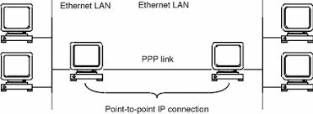
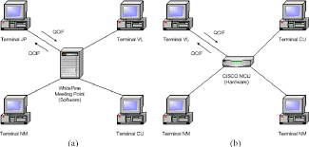
MULTIPOINT
A multipoint (also called multi-drop) connection is one in which more than two specific devices share a single link
In a multipoint environment, the capacity of the channel is shared, either spatially or temporally.
If several devices can use the link simultaneously, it is a spatially shared connection.
If users must take turns, it is a timeshared connection.

Slide 17
NETWORK TOPOLOGY
It is the geometric representation of the relationship of all the links and linking devices (usually called nodes) to one another.
Types:
Mesh
Star
Bus
Ring
Hybrid

Slide 18
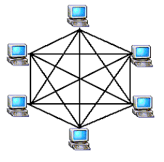
MESH TOPOLOGY
Every device has a dedicated point-to-point link to every other device.
To find the number of physical links in a fully connected mesh network with n nodes, We need n(n - 1) physical links.
However, if each physical link allows communication in both directions (duplex mode), we can divide the number of links by 2. In other words, we can say that in a mesh topology, we need (n(n-1)/2) duplex mode links.

Slide 19
Advantages:
Eliminating the traffic problems because, the use of dedicated links.
A mesh topology is robust. If one link becomes unusable, it does not incapacitate the entire system.
Privacy / Security: When every message travels along a dedicated line, only the intended recipient sees it.
Point-to-point links make fault identification and fault isolation easy.
Disadvantages:
The amount of cabling and the number of I/O ports required. Since every device must be connected to every other device, installation and reconnection are difficult.
The sheer bulk of the wiring can be greater than the available space (in walls, ceilings, or floors) can accommodate.
The hardware required to connect each link (I/O ports and cable) can be prohibitively expensive
Example- The connection of telephone regional offices in which each regional office needs to be connected to every other regional office.

Slide 20
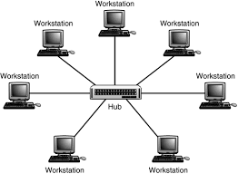
STAR TOPOLOGY
Each device has a dedicated point-to-point link only to a central controller, usually called a hub.
The devices are not directly linked to one another.
The controller acts as an exchange: If one device wants to send data to another, it sends the data to the controller, which then relays the data to the other connected device.

Slide 21
Advantages:
Less expensive than a mesh topology.
It is easy to install and reconfigure because each device needs only one link and one I/O port to connect it to any number of others.
Robustness: If one link fails, only that link is affected. All other links remain active.
Lends itself to easy fault identification and fault isolation.
Disadvantage:
The dependency of the whole topology on one single point, the hub. If the hub goes down, the whole system is dead.
Use: Used in local-area networks (LANs).

Slide 22
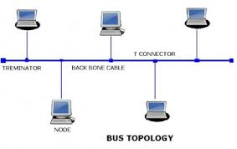
BUS TOPOLOGY
It is multipoint. One long cable acts as a backbone to link all the devices in a network.
Nodes are connected to the bus cable by drop lines and taps. A drop line is a connection running between the device and the main cable.
A tap is a connector that either splices into the main cable or punctures the sheathing of a cable to create a contact with the metallic core.

Slide 23
Advantages:
Easy of installation.
Less cabling than mesh or star topologies.
Cable connection redundancy is eliminated.
Disadvantage:
Difficult reconnection and fault isolation.
Difficult to add new devices because a bus is usually designed to be optimally efficient at installation.
Signal reflection at the taps can cause degradation in quality.
A fault or break in the bus cable stops all transmission, even between devices on the same side of the problem
The first topologies used in the design of early local area networks. Ethernet LANs can use a bus topology, but they are less popular now.

Slide 24
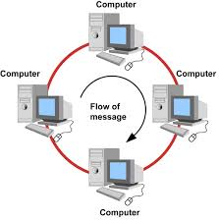
RING TOPOLOGY
Each device has a dedicated point-to-point connection with only the two devices on either side of it.
A signal is passed along the ring in one direction, from device to device, until it reaches its destination.
Each device in the ring incorporates a repeater. When a device receives a signal intended for another device, its repeater regenerates the bits and passes them along.

Slide 25
Advantages:
A ring is relatively easy to install and reconfigure.
Each device is linked to only its immediate neighbors (either physically or logically).
To add or delete a device requires changing only two connections.
Fault isolation is simplified. If one device does not receive a signal within a specified period, it can issue an alarm. The alarm alerts the network operator to the problem and its location.
Disadvantages:
Unidirectional traffic can be a disadvantage. In a simple ring, a break in the ring (such as a disabled station) can disable the entire network.
Higher-speed LANs has made this topology less popular.

Slide 26
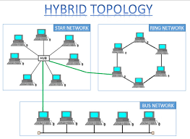
HYBRID TOPOLOGY
A hybrid network is any computer network that uses more than one type of connecting technology or topology
Example: A home network that uses both Wi-Fi and Ethernet cables to connect computers is a hybrid.
Example: We can have a main star topology with each branch connecting several stations in a bus topology

Slide 27
CATEGORIES OF NETWORK
The category into which a network falls is determined by its size.
Local-Area Networks(LAN)-less than 2 Miles
Metropolitan Area Networks(MAN) - less than 10 miles
Wide-Area Networks(WAN) - world wide

Slide 28
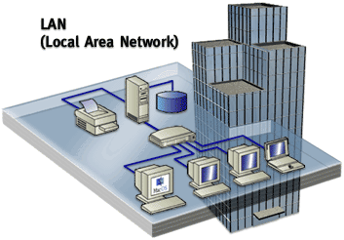
Local-Area Network (LAN)
It is usually privately owned and links the devices in a single office, building, or campus.
LANs are designed to allow resources to be shared between personal computers or workstations.
The resources to be shared can include hardware (e.g., a printer), software(e.g., an application program), or data.
In addition to size, LANs are distinguished from other types of networks by their transmission media and topology(bus, ring, and star.)

Slide 29
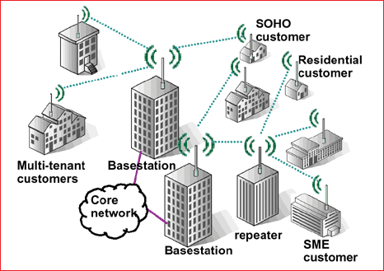
Metropolitan Area Network (MAN)
A Metropolitan Area Network (MAN) is a network with a size between a LAN and a WAN.
It normally covers the area inside a town or a city.
It is designed for customers who need a high-speed connectivity, normally to the Internet, and have endpoints spread over a city or part of city.
Example-Cable TV network

Slide 30
Wide-Area Networks(WAN)
Provides long-distance transmission of data, image, audio, and video information over large geographic areas
Example- Asynchronous Transfer Mode (ATM) network, that may comprise a country, a continent, or even the whole world

Slide 31
PROTOCOL
A set of rules that governs data communication.
A protocol defines what is communicated, how it is communicated, and when it is communicated.
Key elements :
Syntax: The term syntax refers to the structure or format of the data, meaning the order in which they are presented.
Semantics: The word semantics refers to the meaning of each section of bits.
Timing: The term timing refers to two characteristics: When data should be sent and how fast they can be sent.

Slide 32
STANDARDS
Standards provide guidelines to manufacturers, vendors, government agencies, and other service providers to ensure the kind of interconnectivity necessary in today's marketplace and in international communications.
Standards Organizations:
Standards are developed through the cooperation of standards creation committees, forums, and government regulatory agencies.
International Organization for Standardization (ISO)
International Telecommunication Union- Telecommunication Standards Sector (ITU-T)
American National Standards Institute (ANSI)
Institute of Electrical and Electronics Engineers (IEEE)
Electronic Industries Association (EIA)

Slide 33
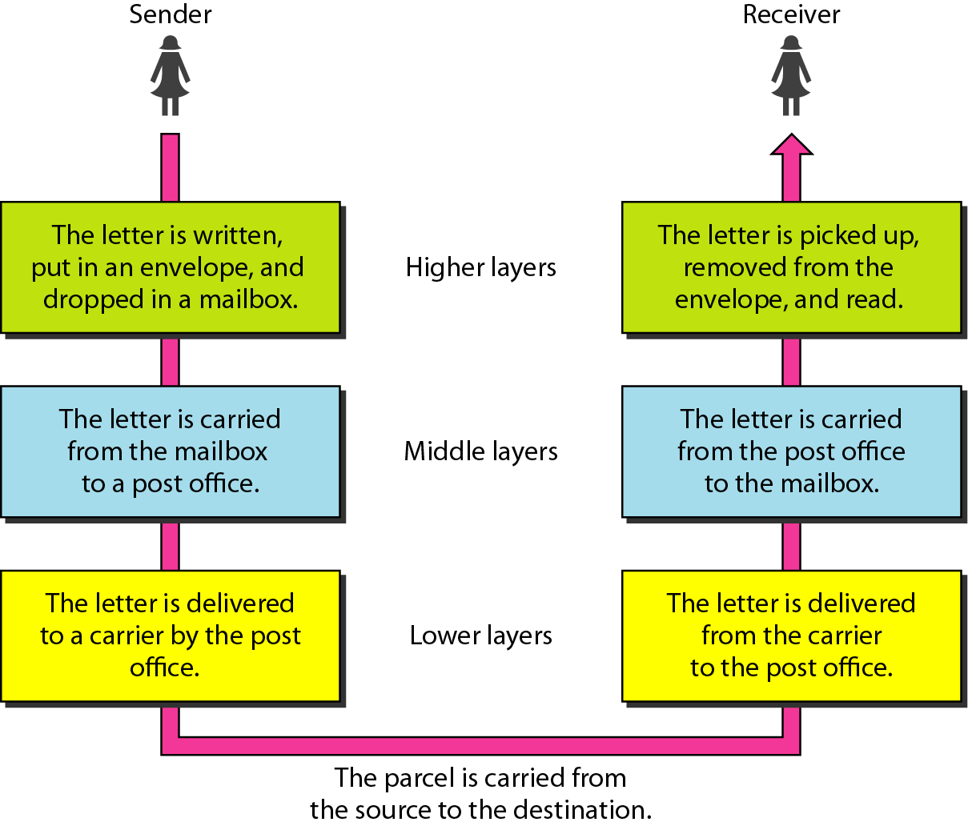
Tasks involved in sending a letter

Slide 34
OSI MODEL
The International Standards Organization (ISO) is Established in 1947.
The International Standards Organization (ISO) is a multinational body dedicated to worldwide agreement on international standards.
It covers all aspects of network communications is the Open Systems Interconnection model.
The Open System Interconnection (OSI) was first introduced in the late 1970s.
The OSI model is not a protocol; it is a model for understanding and designing a network architecture that is flexible, robust, and interoperable.
Purpose : To show how to facilitate communication between different systems without requiring changes to the logic of the underlying hardware and software.
It consists of seven separate but related layers, each of which defines a part of the process of moving information across a network

Slide 35
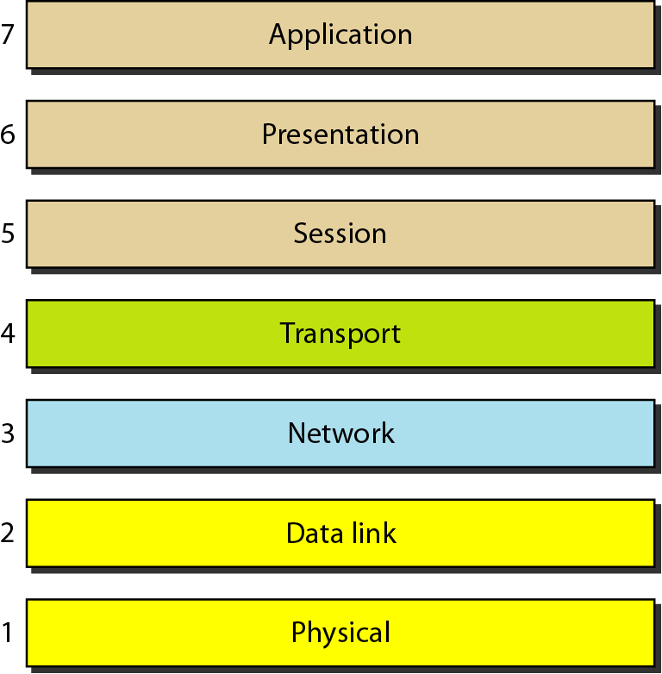
OSI MODEL

Slide 36
A message travels from A to B, it may pass through many intermediate nodes. These intermediate nodes usually involve only the first three layers of the OSI model.
The processes on each machine that communicate at a given layer are called peer-to-peer processes.
Each layer in the sending device adds its own information to the message it receives from the layer just above it and passes the whole package to the layer just below it .
At the receiving machine, the message is unwrapped layer by layer, with each process receiving and removing the data meant for it.
There is an interface between each pair of adjacent layers.
Each interface defines the information and services a layer must provide for the layer above it.

Slide 37
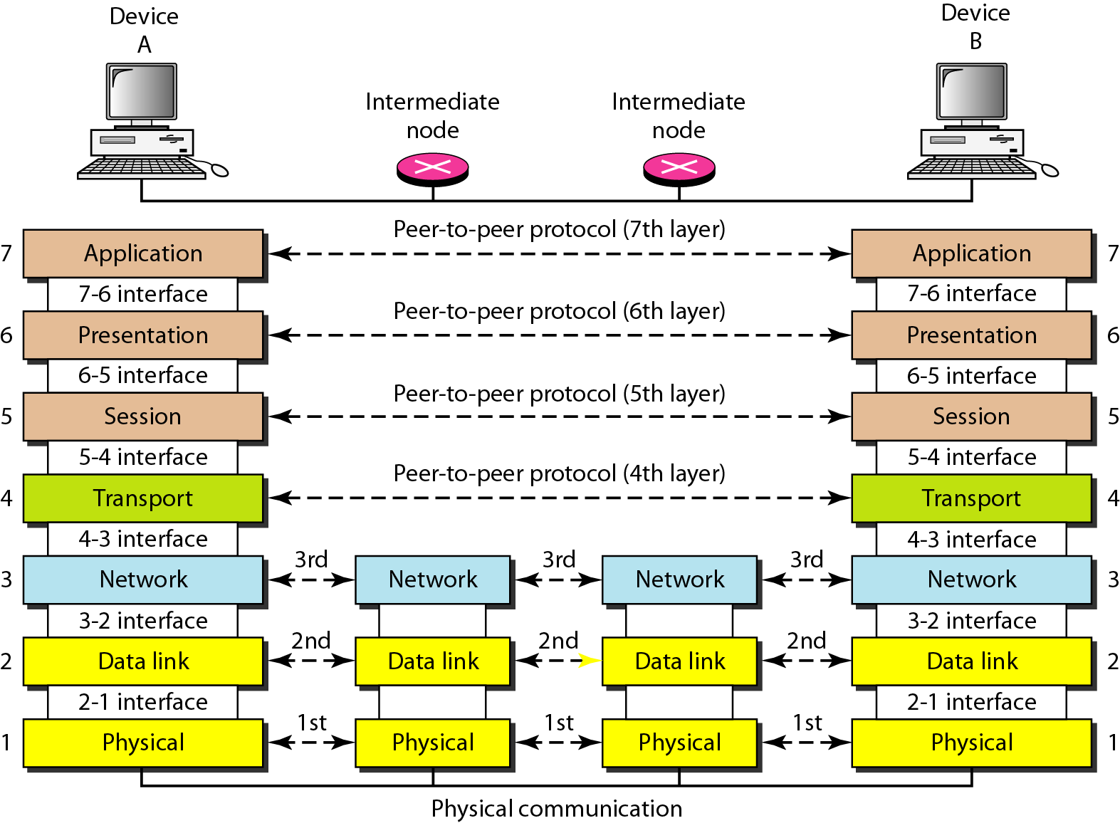
The interaction between layers in the OSI model

Slide 38
Organization of the Layers
Seven Layers can be divided in to 3 sub-groups:
Network support layers : Layer 1, 2 & 3. the physical aspects of moving data from one device to another (such as electrical specifications, physical connections, physical addressing, and transport timing and reliability). It is implemented with combination of hardware and software, except for the physical layer, which is mostly hardware.
User support layers: Layers 5, 6, and 7. They allow interoperability among unrelated software systems. It is implemented in software.
Layer 4, the transport layer, links the two subgroups and ensures that what the lower layers have transmitted is in a form that the upper layers can use.

Slide 39
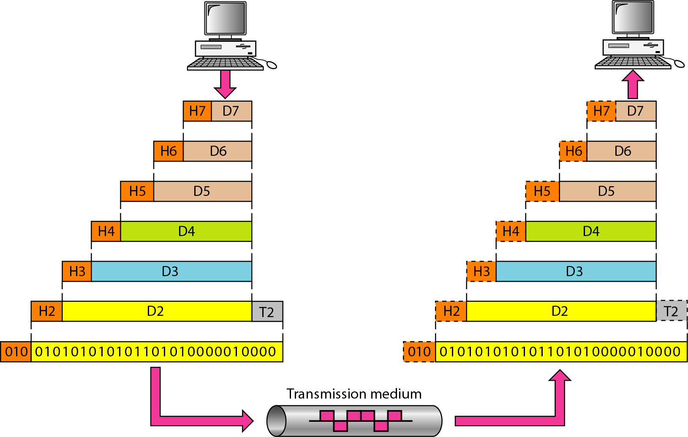
An exchange using the OSI model

Slide 40
The process starts at layer 7 (the application layer), then moves from layer to layer in descending, sequential order.
At each layer, a header, or possibly a trailer, can be added to the data unit. Commonly, the trailer is added only at layer 2. When the formatted data unit passes through the physical layer (layer 1), it is changed into an electromagnetic signal and transported along a physical link.
The data portion of a packet at level N - 1 carries the whole packet (data and header and maybe trailer) from level N. The concept is called encapsulation; level N - 1 is not aware of which part of the encapsulated packet is data and which part is the header or trailer.

Slide 41
Physical Layer
It defines the characteristics of the interface between the devices and the transmission medium. It also defines the type of transmission medium.
It defines the type of encoding (how Os and Is are changed to signals).
Data rate: The transmission rate-the number of bits sent each second-is also defined by the physical layer.
Synchronization of bits: The sender and receiver not only must use the same bit rate but also must be synchronized at the bit level.
Line configuration: The physical layer is concerned with the connection of devices to the media (Point-to-Point / Multipoint).
Physical topology: The physical topology defines how devices are connected to make a network.
Transmission mode: The physical layer also defines the direction of transmission between two devices: simplex, half-duplex, or full-duplex.

Slide 42
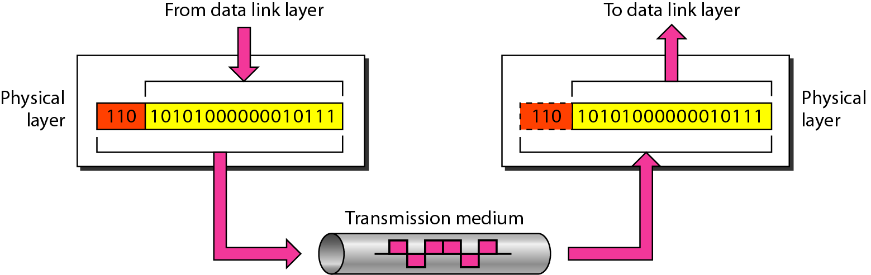
Physical Layer

Slide 43
Data Link Layer
The data link layer transforms the physical layer, a raw transmission facility, to a reliable link i.e. It makes the physical layer appear error-free to the upper layer (network layer)
Framing: The data link layer divides the stream of bits received from the network layer into manageable data units called frames.
Physical addressing: If the frame is intended for a system outside the sender's network, the receiver address is the address of the device that connects the network to the next one.
Flow control: If the rate at which the data are absorbed by the receiver is less than the rate at which data are produced in the sender, the data link layer imposes a flow control mechanism to avoid overwhelming the receiver.
Error control: The data link layer adds reliability to the physical layer by adding mechanisms to detect and retransmit damaged or lost frames. It also uses a mechanism to recognize duplicate frames.
Access control: When two or more devices are connected to the same link, data link layer protocols are necessary to determine which device has control over the link at any given time .

Slide 44
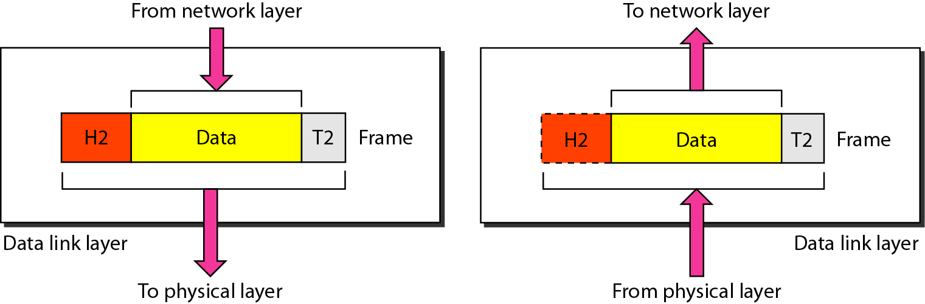
Data Link Layer

Slide 45
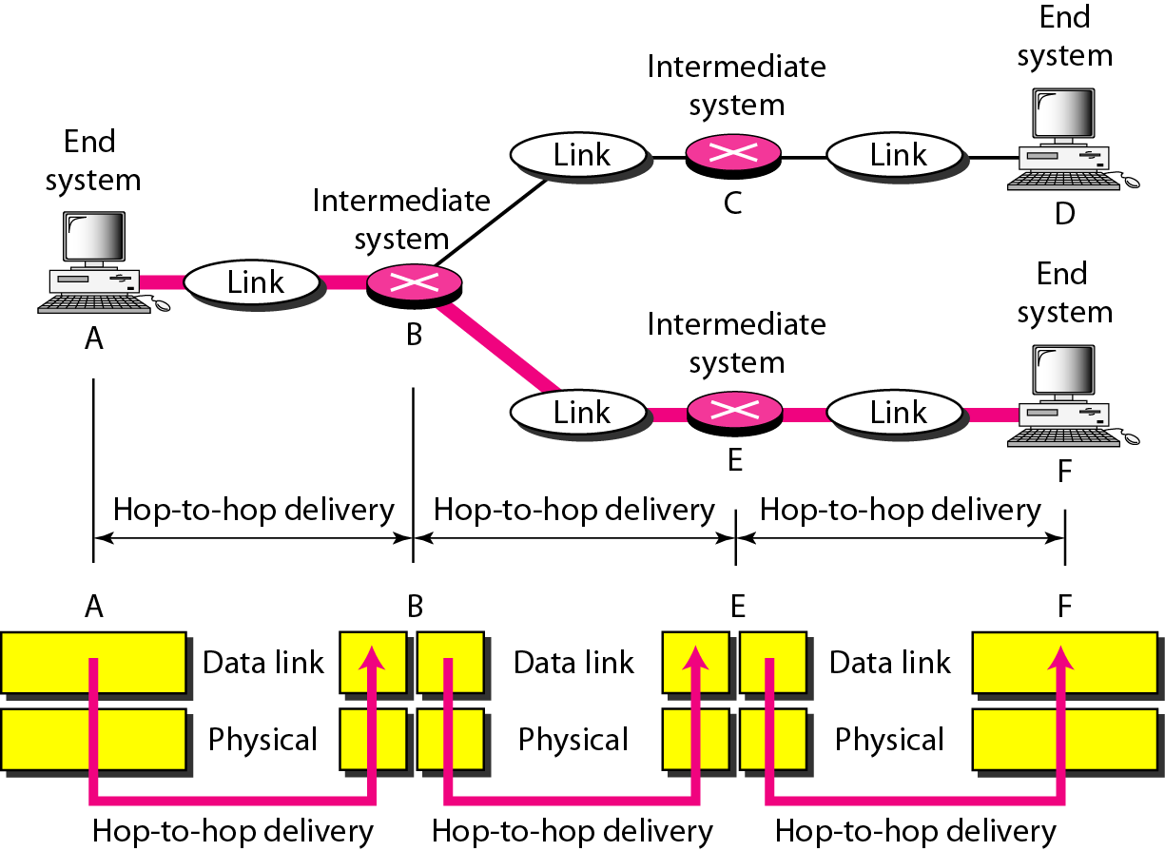
Data Link Layer

Slide 46
Network Layer
It is responsible for the source-to-destination delivery of a packet, possibly across multiple networks (links).
Logical addressing: The physical addressing implemented by the data link layer handles the addressing problem locally.
Routing: When independent networks or links are connected to create internetworks (network of networks) or a large network, the connecting devices (called routers or switches) route or switch the packets to their final destination.

Slide 47
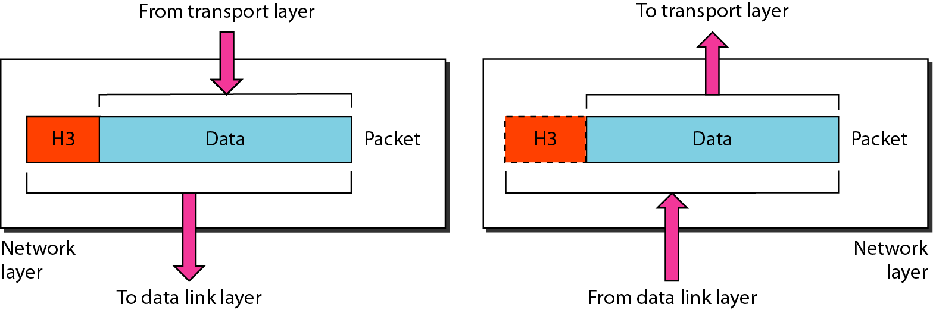
Network Layer

Slide 48
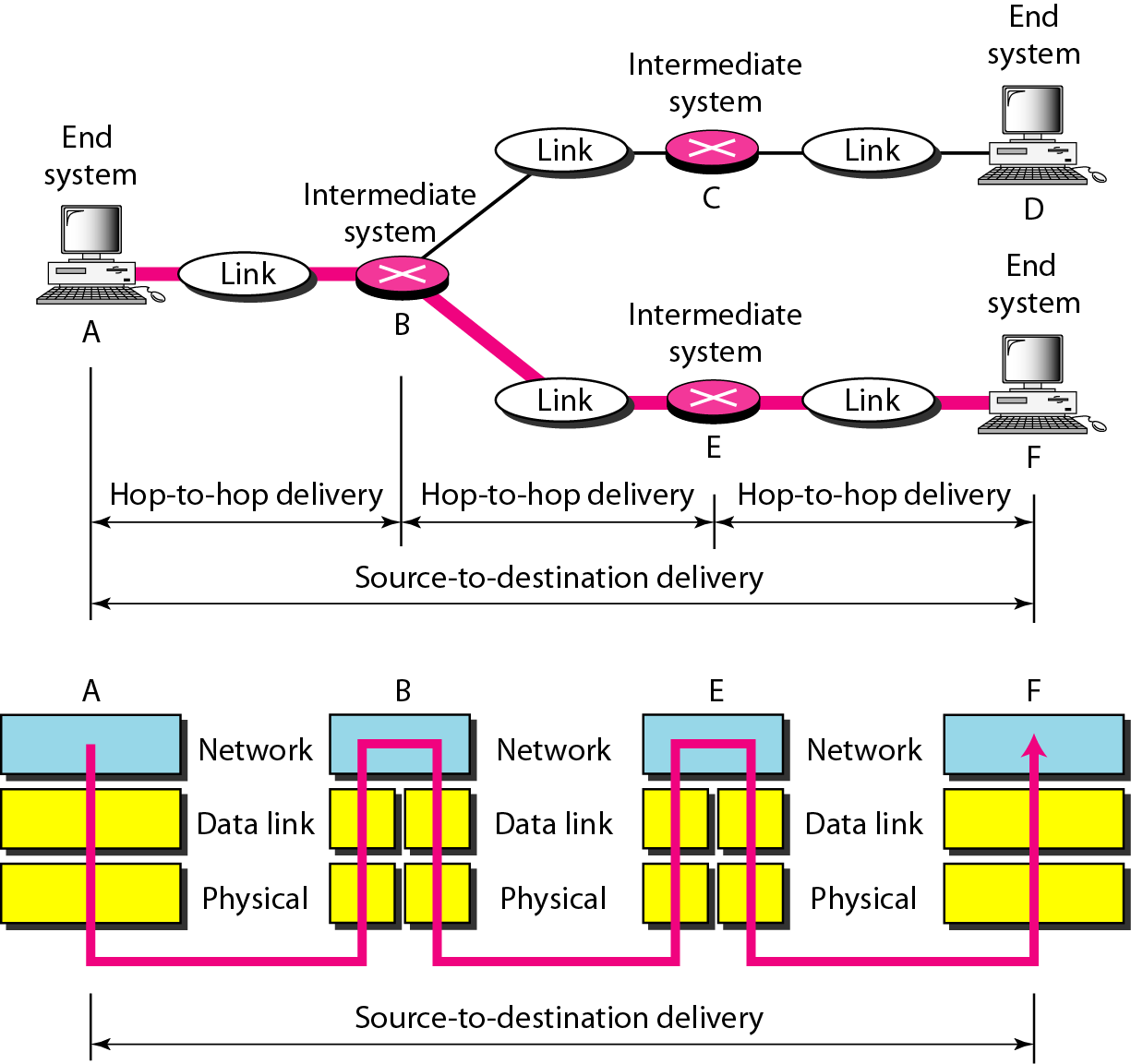
Network Layer

Slide 49
Transport Layer
The transport layer is responsible for process-to-process delivery of the entire message.
Service-point addressing : The transport layer header include a type of address called a service-point address (or port address). The network layer gets each packet to the correct computer.
Segmentation and reassembly: A message is divided into transmittable segments, with each segment containing a sequence number. These numbers enable the transport layer to reassemble the message correctly upon arriving at the destination and to identify and replace packets that were lost in transmission.

Slide 50
Connection control: The transport layer can be either connectionless or connection-oriented. A connectionless transport layer treats each segment as an independent packet and delivers it to the transport layer at the destination machine. A connection-oriented transport layer makes a connection with the transport layer at the destination machine first before delivering the packets. After all the data are transferred, the connection is terminated.
Flow control: Like the data link layer, the transport layer is responsible for flow control.
Error control :error control at this layer is performed process-to-process rather than across a single link.

Slide 51
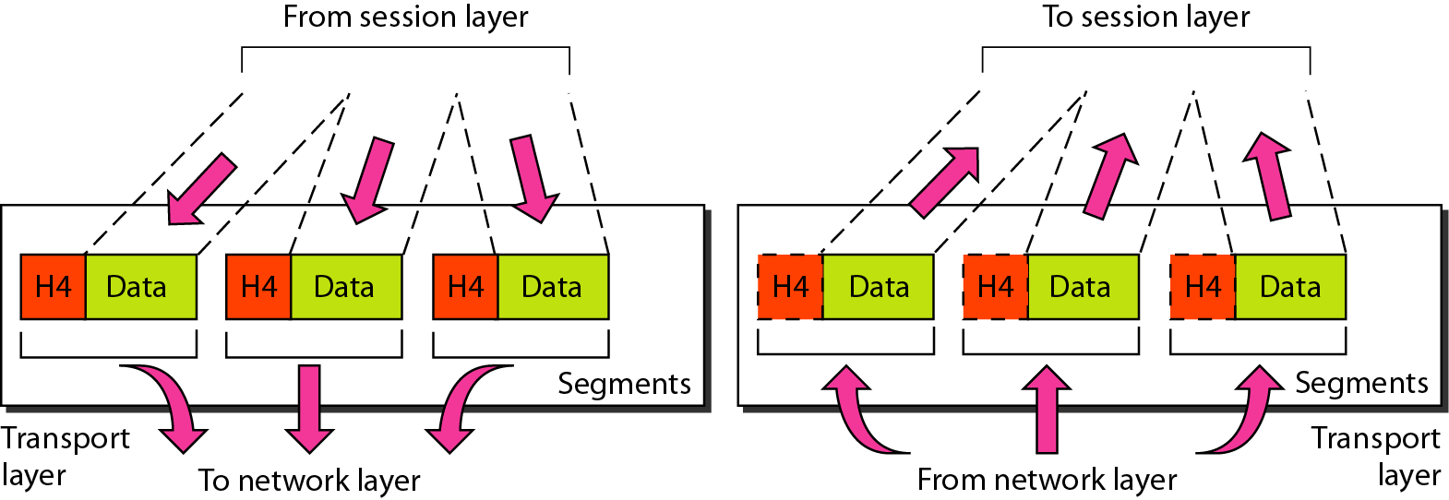
Transport Layer

Slide 52
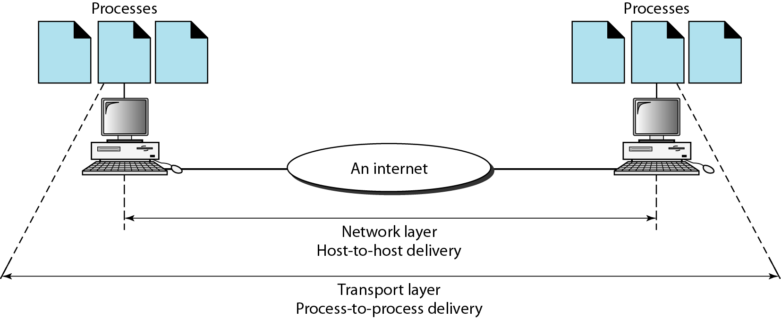
Reliable process-to-process delivery of a message

Slide 53
Session Layer
The session layer is the network dialog controller. It establishes, maintains, and synchronizes the interaction among communicating systems.
Dialog control: The session layer allows two systems to enter into a dialog. It allows the communication between two processes to take place in either half-duplex or full duplex mode.
Synchronization: The session layer allows a process to add checkpoints, or synchronization points, to a stream of data.

Slide 54
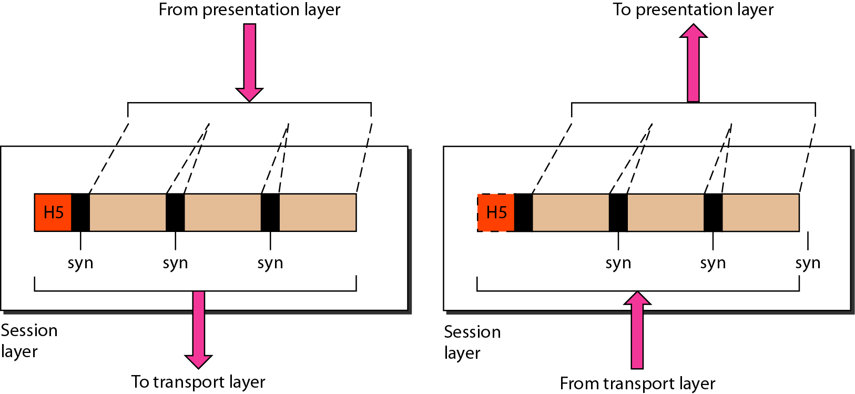
Session Layer

Slide 55
Presentation Layer
The presentation layer is concerned with the syntax and semantics of the information exchanged between two systems.
Dialog control: The session layer allows two systems to enter into a dialog. It allows the communication between two processes to take place in either half-duplex or full duplex mode.
Synchronization: The session layer allows a process to add checkpoints, or synchronization points, to a stream of data.
Translation: Because different computers use different encoding systems, the presentation layer is responsible for interoperability between these different encoding methods. The presentation layer at the sender changes the information from its sender-dependent format in to a common format. The presentation layer at the receiving machine changes the common format into its receiver-dependent format.
Encryption / Decryption: To carry sensitive information, a system must be able to ensure privacy.
Compression: Data compression becomes particularly important in the transmission of multimedia such as text, audio, and video.

Slide 56
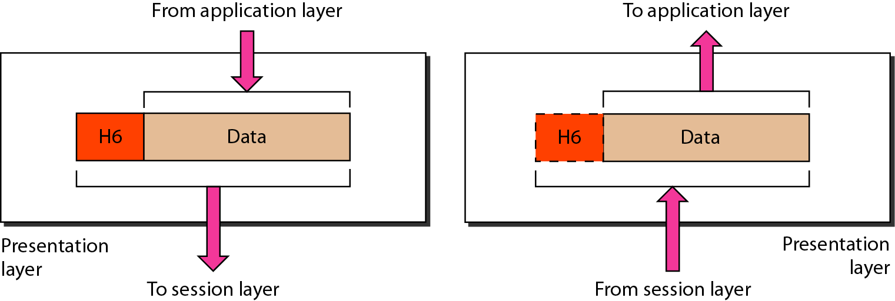
Presentation Layer

Slide 57
Application Layer
The application layer enables the user, whether human or software, to access the network.
It provides user interfaces and support for services such as electronic mail, remote file access and transfer, shared database management, and other types of distributed information services.
Network virtual terminal: A network virtual terminal is a software version of a physical terminal, and it allows a user to log on to a remote host.
File transfer, access, and management:
Mail services: This application provides the basis for e-mail forwarding and storage.
Directory services: This application provides distributed database sources and access for global information about various objects and services.

Slide 58
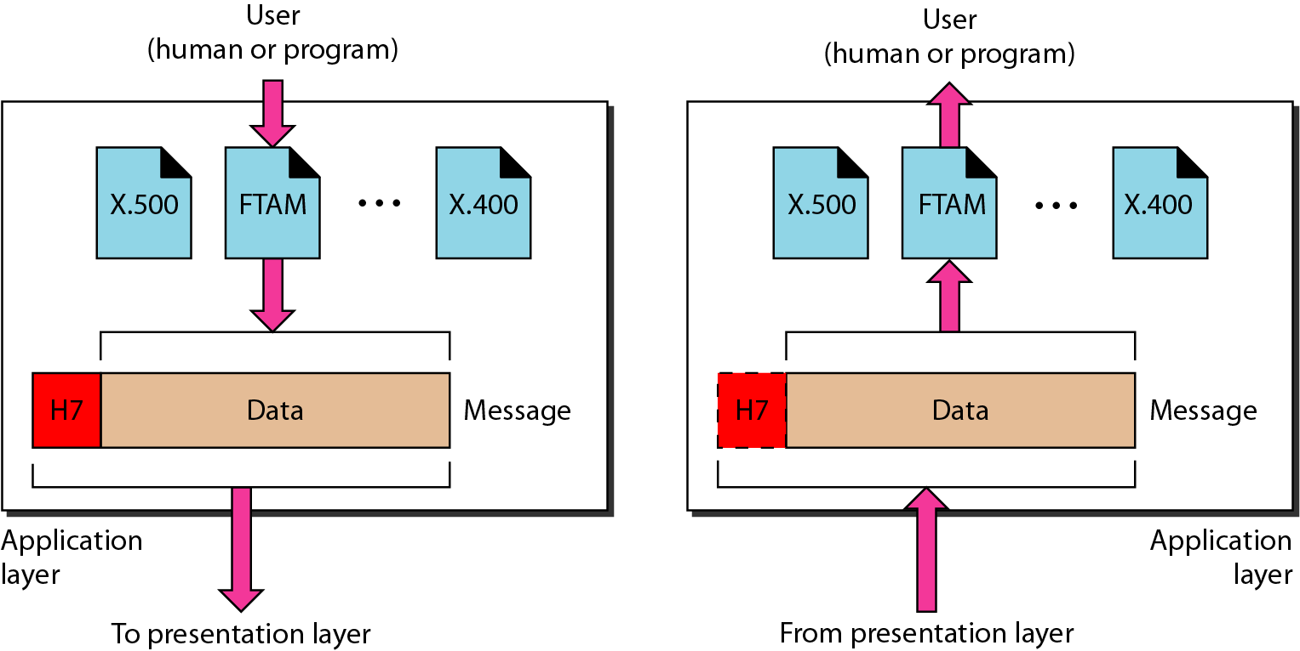
Application Layer

Slide 59
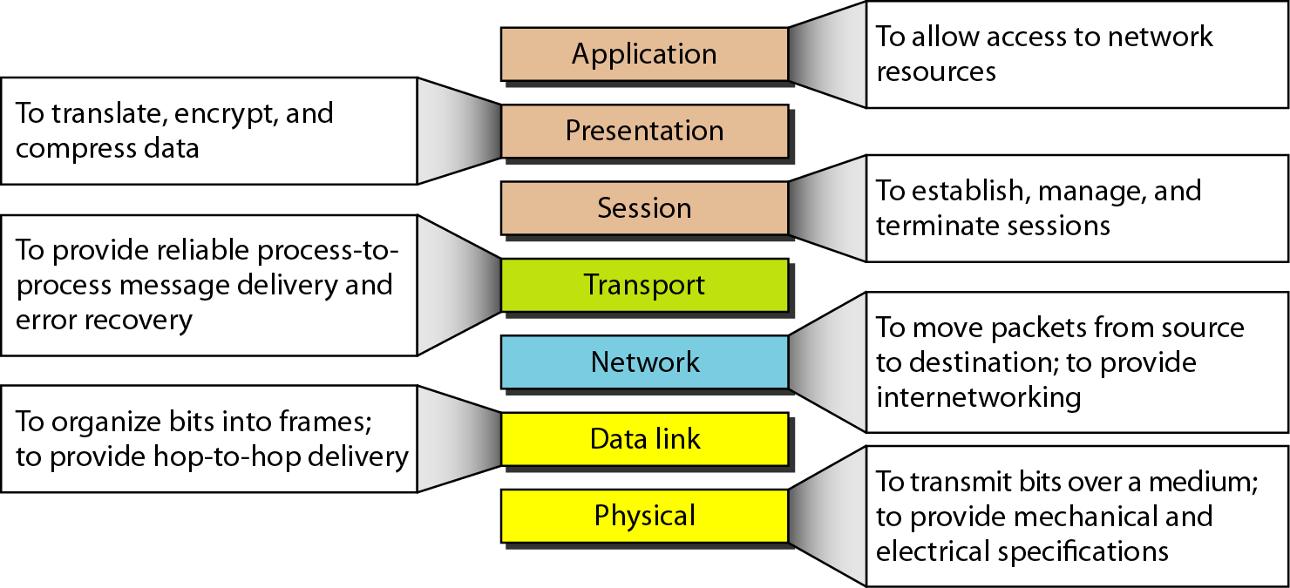
Summary of Layers

Slide 60
TCP/IP Protocol
The TCP/IP protocol suite was developed prior to the OSI model
The original TCP/IP protocol suite was defined as having 4 layers:
Host-to-network (Physical and Data link layers )
Internet (Network layer)
Transport and
Application (Session, Presentation, and Application layers)
We assume that the TCP/IP protocol suite is made of five layers: Physical, Data link, Network, Transport, and Application

Slide 61
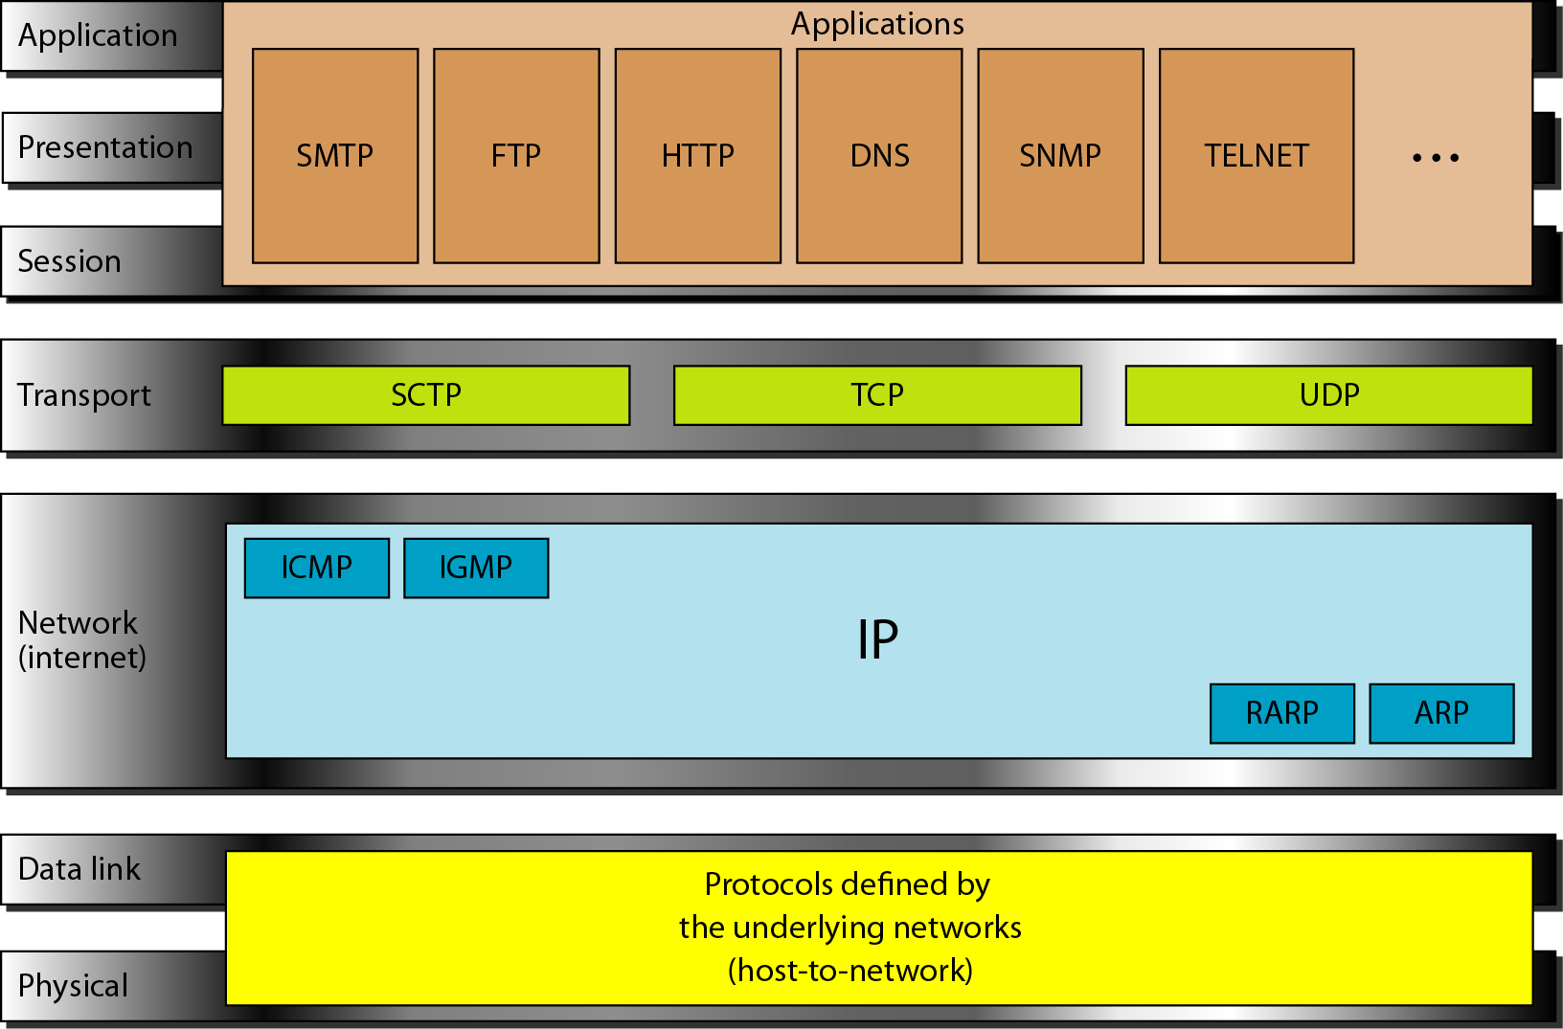
TCP/IP and OSI Model

Slide 62
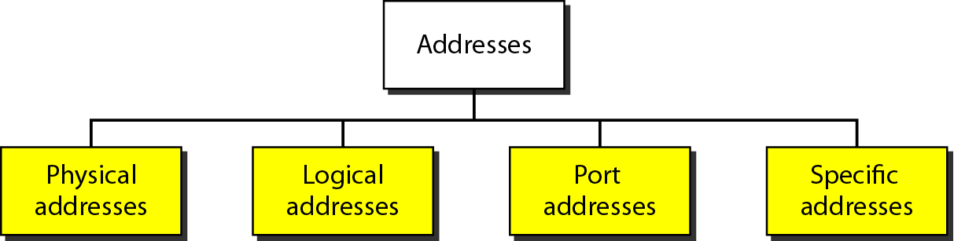
Addresses in TCP/IP

Slide 63
Physical Address
The physical address, also known as the link address, is the address of a node as defined by its LAN or WAN.
It is included in the frame used by the data link layer.
It is the lowest-level address.
Example: Ethernet uses a 6-byte (48-bit) physical address that is imprinted on the network interface card (NIC).
07:01:02:01 :2C:4B

Slide 64
Logical address
Logical addresses are necessary for universal communications that are independent of underlying physical networks.
A logical address in the Internet is currently a 32-bit address that can uniquely define a host connected to the Internet.
The physical addresses will change from hop to hop, but the logical addresses usually remain the same.

Slide 65
Port address
The IP address and the physical address are necessary for a quantity of data to travel from a source to the destination host.
The objective of Internet communication is a process communicating with another process.
A port number can range from 0-65535 (16-bit integer ).
A port number is a way to identify a specific process to which an Internet or other network message is to be forwarded when it arrives at a server.

Slide 66
Specific Addresses
Applications having user-friendly addresses that are designed for that specific address.
Examples : e-mail address , URL

Slide 67
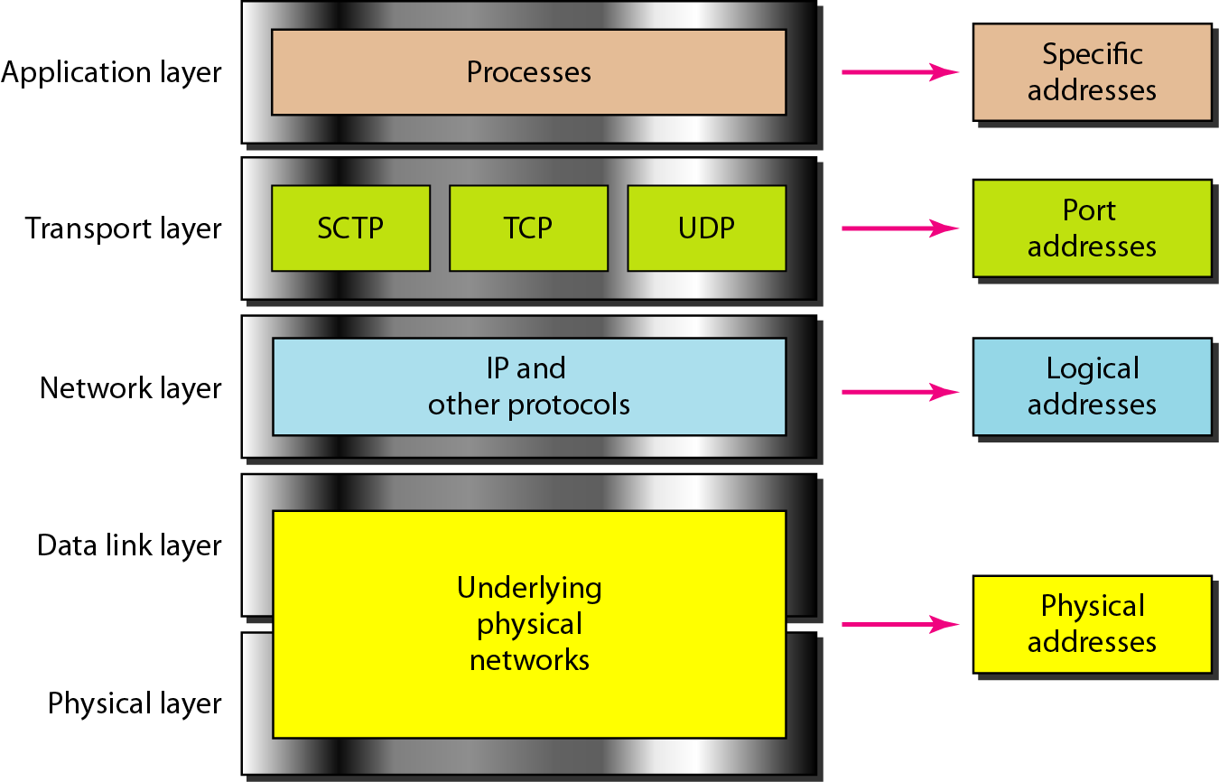
Relationship of Layers and Addresses in TCP/IP

Slide 68
REFRENCES
“ DATA COMMUNICATIONS AND NETWORKING ”, Behrouz A. Forouzan And Sophia Chung Fegan , Fourth Edition , McGraw-Hill

